Slide 1
Lecture 9
Gauss Quadrature

Slide 2







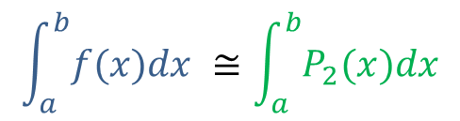






Introduction
$$\int_{a}^{b}{f(x)dx} ≅\int_{a}^{b}{P_{2}(x)dx}$$
Newton-Cotes quadrature formula allow to approximate numerically defined integrals
They are based on polynomial interpolation where we did choose the interpolating points uniformly distributed across the integration interval
$$y$$
$$y=f(x)$$
$$y=P_{2}(x)$$
$$h$$
$$h$$
$$h$$
$$h$$
$$x$$
$$a{=x}_{o}$$
$$x_{1}$$
$$x_{2}$$
$$x_{3}$$
$$b=x_{4}$$
Notes:
Newton-Cotes quadrature formula allow to approximate numerically defined integrals
They are based on polynomial interpolation where we did choose the interpolating points uniformly distributed across the integration interval
A natural question that arises is: if we place the interpolation points differently than uniformly distributed, can we get a better approximation of the integral?

Slide 3
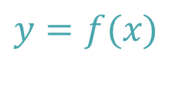













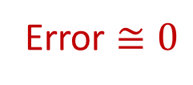
Key Idea of Gauss Quadrature
Newton-Cote
Gauss quadrature
$$y=P_{1}(x)$$
$$y$$
$$y$$
$$y=f(x)$$
$$y=f(x)$$
+
-
Error
-
$$y=P_{1}(x)$$
Error $≅0$
$$a=x_{o}$$
$$x$$
$$a$$
$$x_{o}$$
$$x_{1}$$
$$b$$
$$x$$
$$b=x_{1}$$
Notes:
This question leads naturally to the Gauss quadrature methods
Let us consider the example of two interpolation points
In Newton-Cotes quadrature the interpolating points are the start and end points of the interval
This leads usually to a rather large error as it is the case on the figure
In Gauss quadrature we try a different approach
Can’t we place the two interpolation points in a smarter location in order to minimize the error of the quadrature formula?
As illustrated on the right figure, such smarter locations certainly exist
In the example on the slide the two interpolation points are chosen such that the error of the Quadrature formula is nearly zero
This is possible because in some regions the quadrature formula under-estimates the surface and in some other it over-estimates it
In this lecture we will not explain how such smarter locations can be found but we will discuss how we can use quadrature formulas once these points are defined

Slide 4
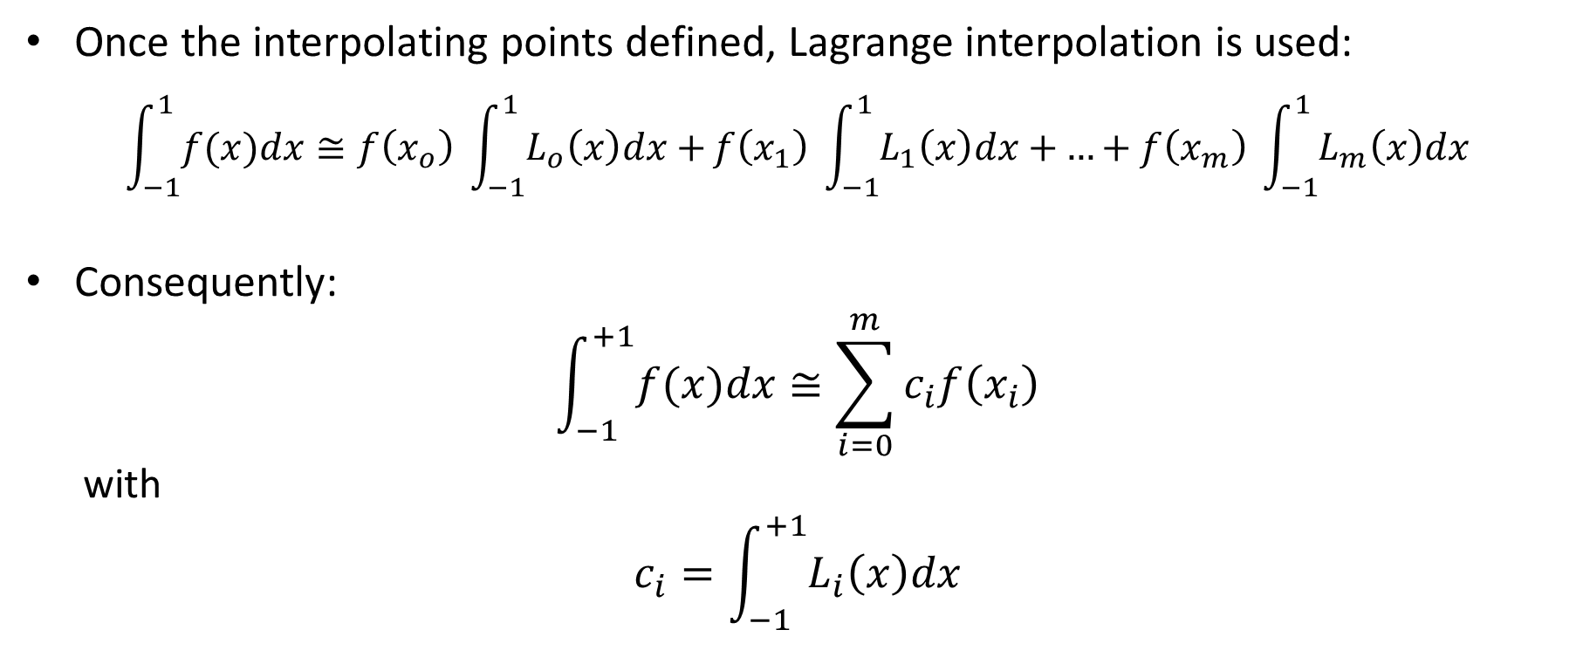
Gauss Quadrature Formulas
Once the interpolating points defined, Lagrange interpolation is used:
$$\int_{−1}^{1}{f(x)dx}≅f\left(x_{o}\right) \int_{−1}^{1}{L_{o}\left(x\right)dx+}f\left(x_{1}\right) \int_{−1}^{1}{L_{1}\left(x\right)dx+}…+f\left(x_{m}\right) \int_{−1}^{1}{L_{m}\left(x\right)dx}$$
Consequently:
$$\int_{−1}^{+1}{f(x)dx}≅\sum_{i=0}^{m}{c_{i}f\left(x_{i}\right)}$$
with
$$c_{i}=\int_{−1}^{+1}{L_{i}\left(x\right)dx}$$
Notes:
One way to choose the interpolation points, among others, results in the so-called Gauss quadrature formulas
It turns out that the location of the interpolation points which will minimize the error of the quadrature formula depends on the start and end point of the integration interval
For that reason, these points are calculated for a standard interval. The usual choice is the interval [-1, +1]
Once the interpolating points defined, Lagrange interpolation is used to interpolate the function f to be integrated
In the exactly same way we did for Newton Cotes formula, we integrate the interpolating polynomial
This results in a quadrature formula which is the sum of coefficients ci times the function evaluated in the interpolating points xi
The coefficients ci are the defined integrals from -1 to +1 of the Lagrange polynomials

Slide 5
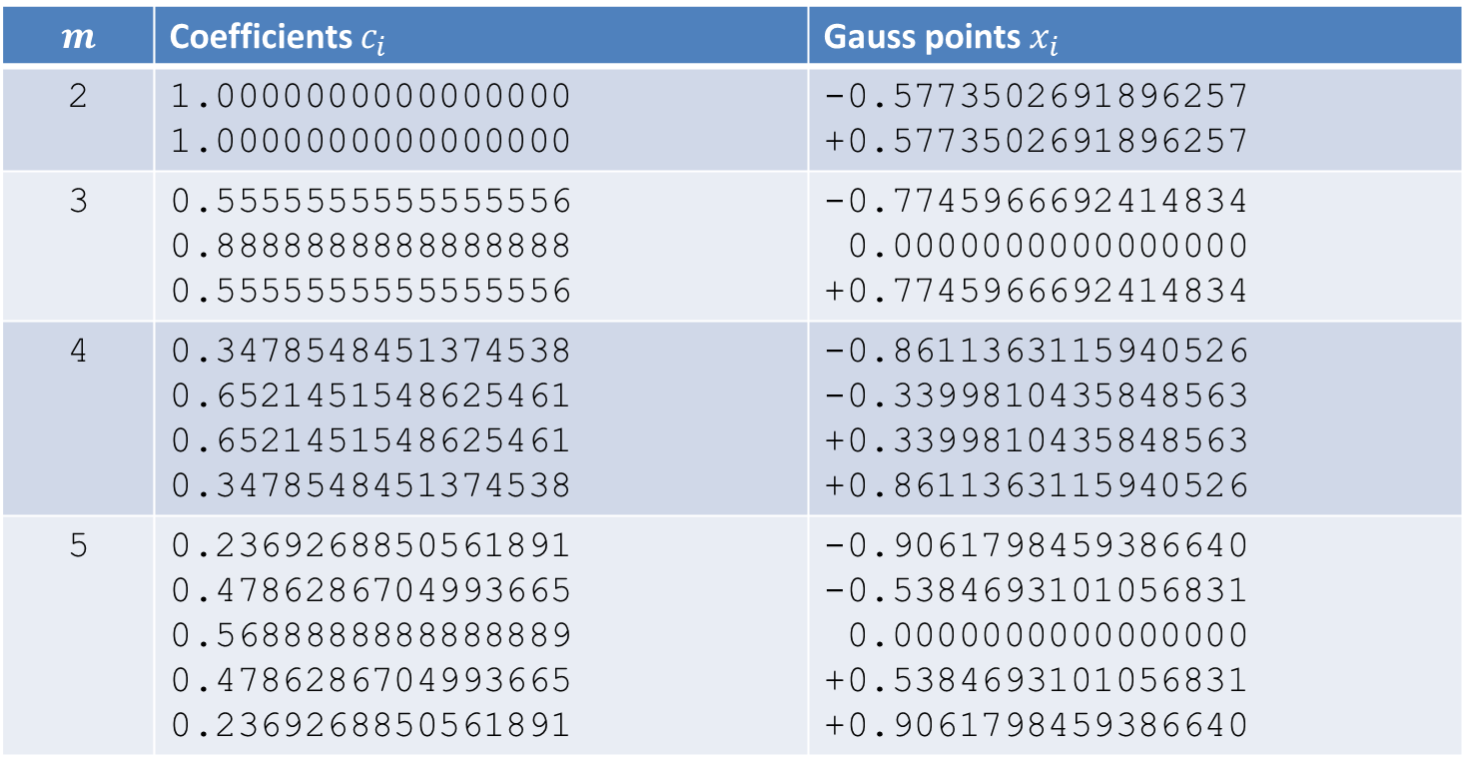
Gauss Quadrature Formulas
$$m$$ | Coefficients $c_{i}$ | Gauss points $x_{i}$
2 | 1.0000000000000000 1.0000000000000000 | -0.5773502691896257 +0.5773502691896257
3 | 0.5555555555555556 0.8888888888888888 0.5555555555555556 | -0.7745966692414834 0.0000000000000000 +0.7745966692414834
4 | 0.3478548451374538 0.6521451548625461 0.6521451548625461 0.3478548451374538 | -0.8611363115940526 -0.3399810435848563 +0.3399810435848563 +0.8611363115940526
5 | 0.2369268850561891 0.4786286704993665 0.5688888888888889 0.4786286704993665 0.2369268850561891 | -0.9061798459386640 -0.5384693101056831 0.0000000000000000 +0.5384693101056831 +0.9061798459386640
Notes:
The table displayed show examples of the coefficients ci and interpolating points xi
The examples listed are for the case of 2,3,4 and 5 interpolating points
This table is enough to be able to apply Gauss quadrature formulas
We will do an example for using the Gauss quadrature formula for two and four interpolating points
Take a minute to write down on a paper the coefficients ci and xi for these cases

Slide 6
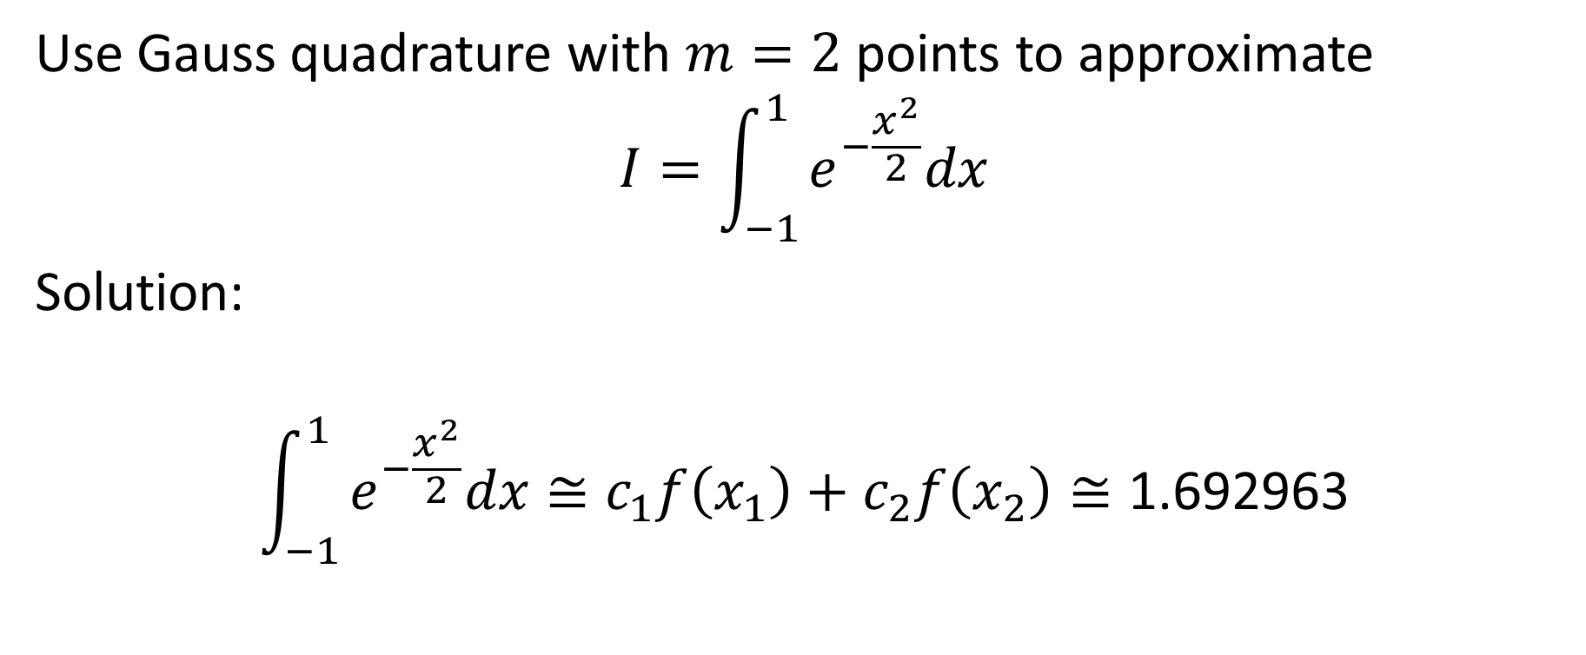

Example
Use Gauss quadrature with $m=2$ points to approximate
$$I=\int_{−1}^{1}{e^{−\frac{x^{2}}{2}}dx}$$
Solution:
$$\int_{−1}^{1}{e^{−\frac{x^{2}}{2}}dx}≅c_{1}f\left(x_{1}\right)+c_{2}f\left(x_{2}\right)≅\text{1.692963}$$
$${f\left(x\right)=e}^{−\frac{x^{2}}{2}}$$
=1
=1
= -0.577350
= +0.577350
Notes:
Let us illustrate the use of this table by applying it to the defined integral from -1 to +1 of $e^{−\frac{x^{2}}{2}}$
We want to use the Gauss quadrature for m=2 interpolation points
The solution is straight forward
We have to compute $c_{1}f\left(x_{1}\right)+c_{2}f\left(x_{2}\right)$
We use the values for c1 and c2 you wrote down on your paper
That is c1=1 and c2=1
The interpolating points are x1=-0.577350 and x2=+0.577350
And f(x) is $e^{−\frac{x^{2}}{2}}$
Combining all this results in the value of 1.692963 for the defined integral

Slide 7
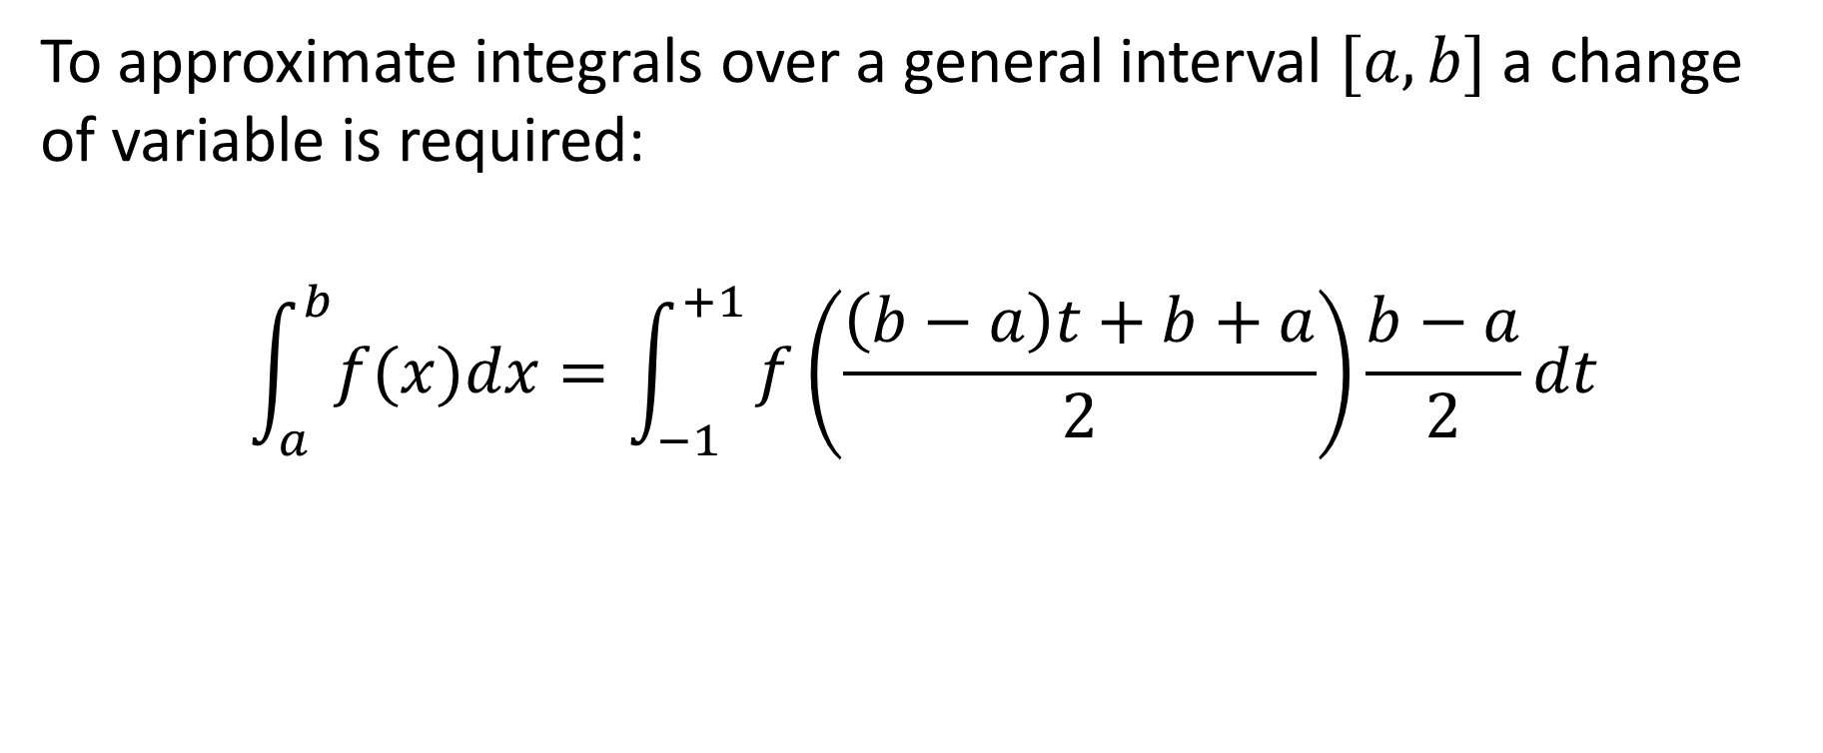
Change of variable
To approximate integrals over a general interval $[a,b]$ a change of variable is required:
$$\int_{a}^{b}{f(x)dx}=\int_{−1}^{+1}{f\left(\frac{\left(b−a\right)t+b+a}{2}\right)\frac{b−a}{2}dt}$$
Notes:
Most often the defined integral we want to calculate will be over a different interval than the standard interval of [-1, +1]
These situations can as well be handled by Gauss quadrature
One only needs to proceed with a change of variable to transform the integration interval [a,b] to the standard interval [-1, +1]
The change of variable is displayed on the slide

Slide 8
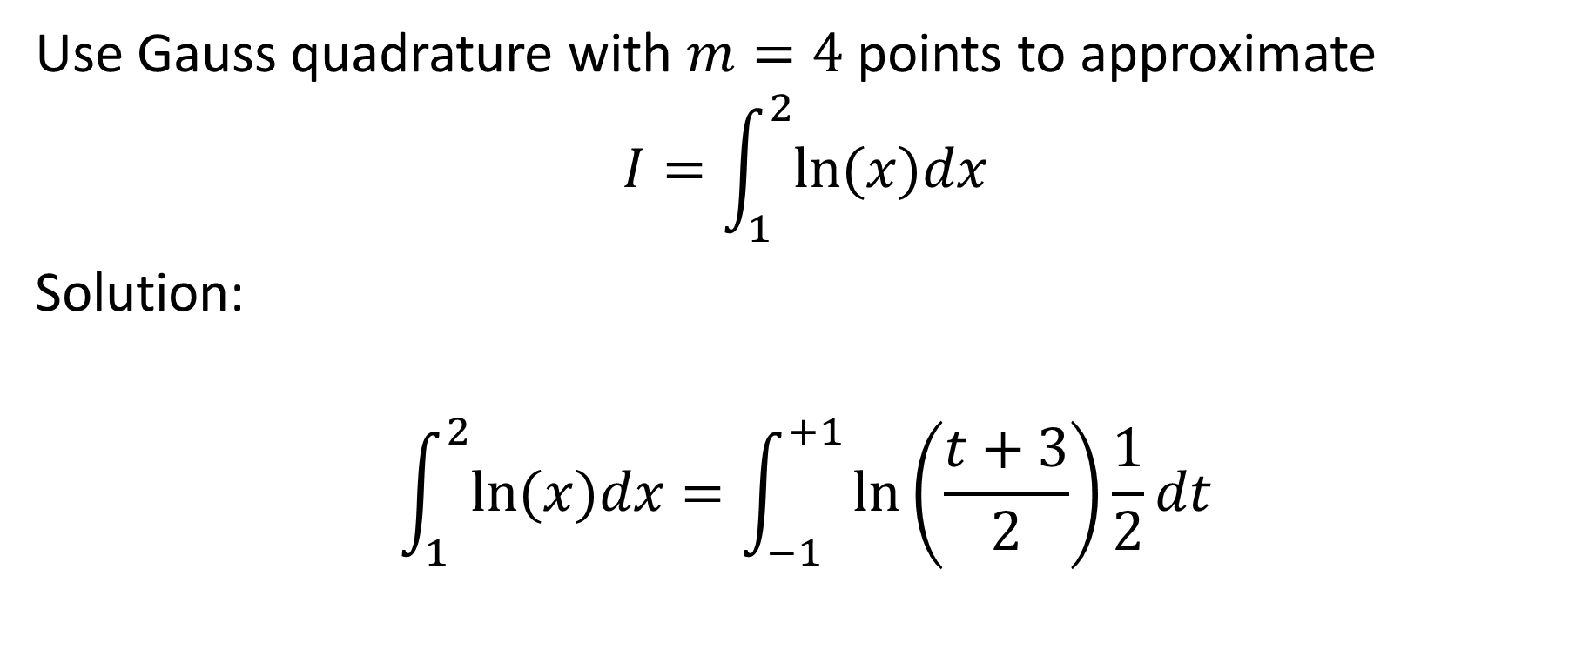
Example
Use Gauss quadrature with $m=4$ points to approximate
$$I=\int_{1}^{2}{ln⁡(x)dx}$$
Solution:
$$\int_{1}^{2}{ln⁡(x)dx}=\int_{−1}^{+1}{ln⁡\left(\frac{t+3}{2}\right)\frac{1}{2}dt}$$
Notes:
To illustrate the use of this change of variable let us apply the Gauss quadrature formula for the defined integral from 1 to 2 of the natural log function
We will use the Gauss quadrature formula for m=4 interpolating points
To solve this problem we first proceed with the change of variable
This brings us to a defined integral from -1 to +1 of $ln\left(\frac{t+3}{2}\right)\frac{1}{2}$

Slide 9
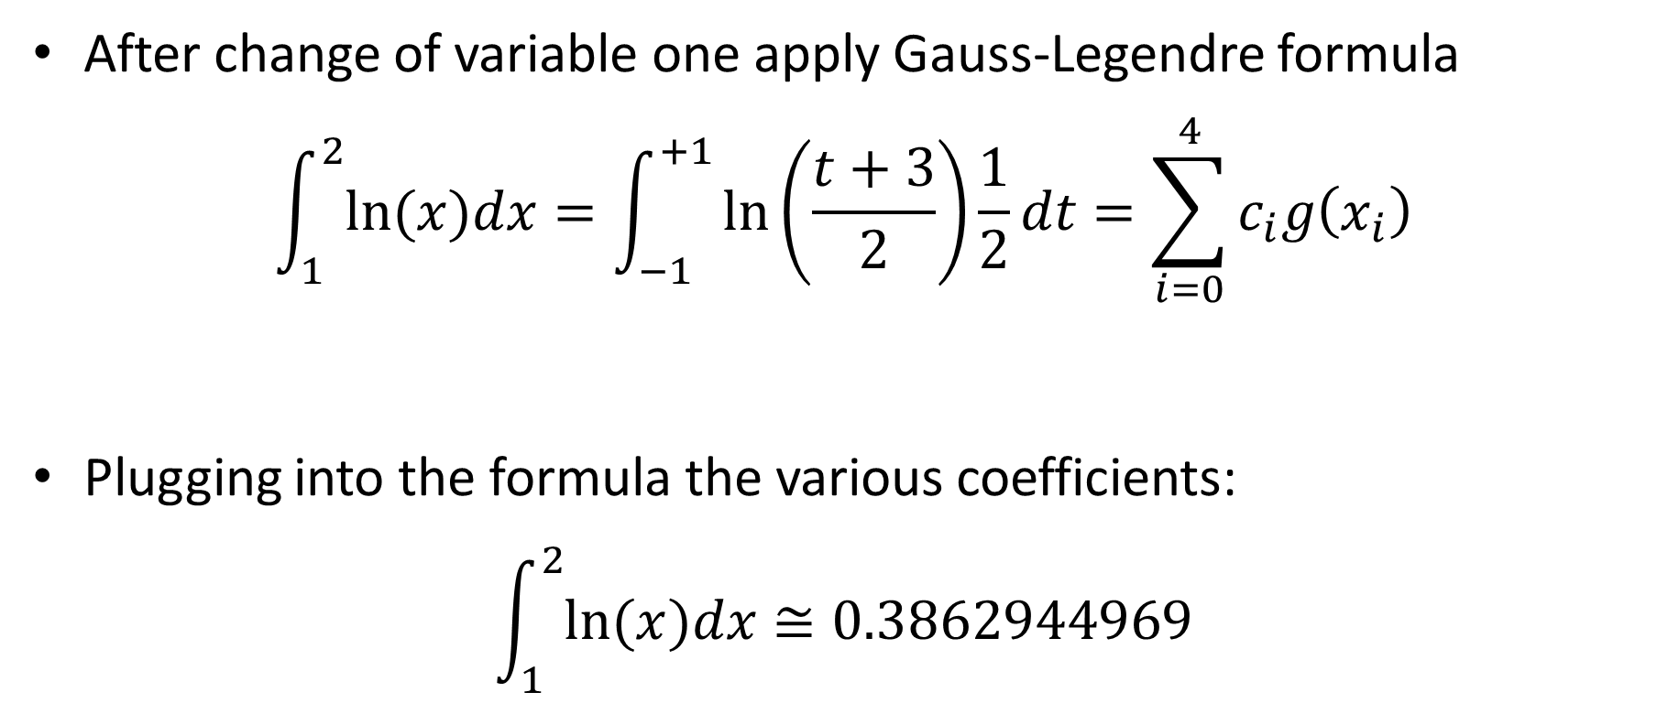
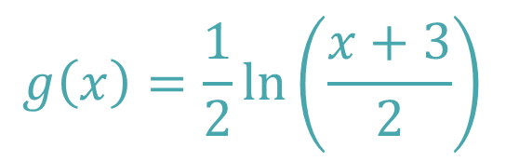
Example
After change of variable one apply Gauss-Legendre formula
$$\int_{1}^{2}{ln⁡(x)dx}=\int_{−1}^{+1}{ln⁡\left(\frac{t+3}{2}\right)\frac{1}{2}dt}=\sum_{i=0}^{4}{c_{i}g\left(x_{i}\right)}$$
Plugging into the formula the various coefficients:
$$\int_{1}^{2}{ln⁡(x)dx}≅0.3862944969$$
$$g\left(x\right)=\frac{1}{2}ln⁡\left(\frac{x+3}{2}\right)$$
Notes:
We then use our table to get the coefficients ci and interpolating points xi and compute the sum of the products ci*g(xi)
The function g(x) is the one we defined after our change of variable: $\frac{1}{2}ln\left(\frac{x+3}{2}\right)$
Combining all this results in the approximation of $0.3862944969$

Slide 10
Summary
Gauss quadrature places the interpolating points in a way to minimize the error of the resulting quadrature formula
The interpolating points and corresponding coefficients of Gauss quadrature formulas are computed for standard intervals [-1,+1]
A change of variable allows to handle defined integrals over general intervals [a,b]
Notes:
Let us summarize the key findings
Gauss quadrature places the interpolating points in a way to minimize the error of the resulting quadrature formula
The interpolating points and corresponding coefficents of Gauss quadrature formulas are computed for standard intervals [-1,+1]
A change of variable allows to handle defined integrals over general intervals [a,b]

